Slide 2
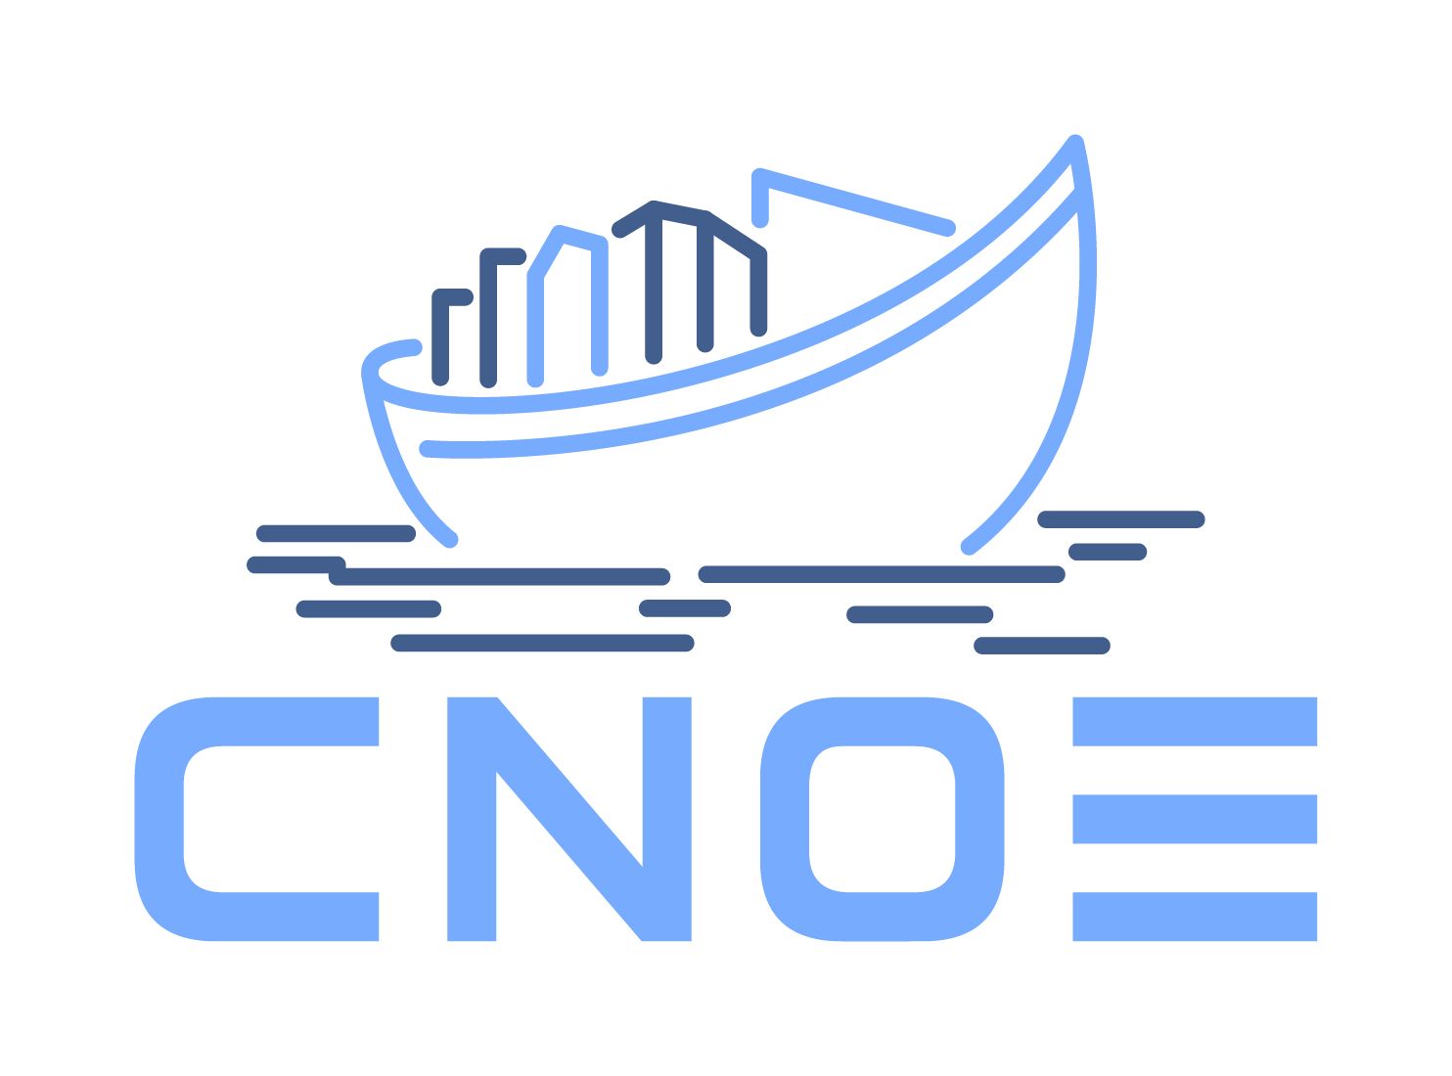

Unveiling Cloud Native Operational Excellence (CNOE)
Pioneering the Future of IDPs

Slide 3

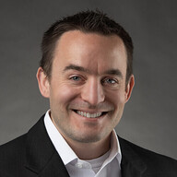
Speakers
Tiara Sykes
Software Engineer
Luke Philips
Staff Software Engineer

Slide 4
Defining a “Platform”
Mission
Support
Architecture

Slide 5
Mission Statements
Mission
Support
Architecture

Slide 6
Mission
“We seek the truth and help people understand the world”

Slide 7
AUDIO
N E W S
GAMES
THE ATHLETIC
COOKING
WIRECUTTER

Slide 8
The New York Times Engineering Mission
“To build high quality, technically excellent solutions that enable people to seek the truth and better understand the world in an increasingly diverse number of ways.”

Slide 9
Platform Support
Mission
Support
Architecture

Slide 10

Ideal State of Application Developer
Principles
Support
Architecture
Develop
Application Developer

Slide 11
Reality of Application Developer
Principles
Support
Architecture
Develop
Container Image
Container Runtime
Container Orchestration
Containerize
Infrastructure as Code
Configuration Management
Provision
Orchestration
Artifact Management
Continuous Integration
Build, Test, Deploy
Continuous Deployment
Application Developer
Ingress Controllers
Route
Service Discovery
Network Policies
Metrics
Monitor
Logging
Tracing

Slide 12
What is an IDP?
Principles
Support
Architecture
An Internal Developer Platform (IDP) is built by a platform team to build golden paths and enable developer self-service.
Application Configuration Management | Manage application configuration in a dynamic, scalable and reliable way.
Infrastructure Orchestration | Orchestrate your infrastructure in a dynamic and intelligent way depending on the context.
Environment Management | Enable developers to create new and fully provisioned environments whenever needed.
Deployment Management | Implement a delivery pipeline for Continuous Delivery or even Continuous Deployment (CD).
Role-Based Access Control | Manage who can do what in a scalable way.

Slide 13
IDP @ The New York Times
The Delivery Engineering Shared Platform (DVSP) is designed to create a set of tools and capabilities that any developer at The New York Times can use to accelerate work. This aligns with The Times’ enterprise goal of “Use technology and data to propel our growth.”

Slide 14
Platform Architecture
Mission
Support
Architecture

Slide 15

Internal Developer Platform
Principles
Support
Architecture
Feature Team
Cloud provider (dev)
Cloud provider (prd)

Slide 16


Shared Clusters
Principles
Support
Architecture
Shared Dev Cluster
Feature Teams
Owns, Manages
Shared Stg Cluster
Delivery Engineering
Shared Prd Cluster

Slide 17
How it Started
Principles
Support
Architecture

Slide 18

How it started - GitOps all the things
Principles
Support
Architecture

Slide 19

How it started - Backstage!
Principles
Support
Architecture

Slide 20
Platform Development
Principles
Support
Architecture

Slide 21
Platform Architecture
Mission
Support
Architecture
as a distribution

Slide 22

What is a Distribution?
Principles
Support
Architecture
A Linux distro
is an operating system made from a software collection that is based upon the Linux kernel and, often, a package management system.

Slide 23

What is a Distribution?
Principles
Support
Architecture
A Linux distro
An IDP Distribution
is an operating system made from a software collection that is based upon the Linux kernel and, often, a package management system.
is a developer platform made from a software collection that is based upon Kubernetes, as well as a package management system.

Slide 24
Cloud Native Operational Excellence (CNOE)
Principles
Support
Architecture
CNOE is an internal developer platform (IDP) distribution built in the open in collaboration with the user community to help with delivering a platform powered by CNCF technologies

Slide 25
Why does building a Distribution matter?
Principles
Support
Architecture
It gets us past technology choices

Slide 26
Why does building a Distribution matter?
Principles
Support
Architecture
It gets us past technology choices
The focus shifts on improving technologies used

Slide 27
Why does building a Distribution matter?
Principles
Support
Architecture
It gets us past technology choices
The focus shifts on improving technologies used
We shift to defining best practices

Slide 28
Platform Architecture
Mission
Support
Architecture
Capabilities

Slide 29
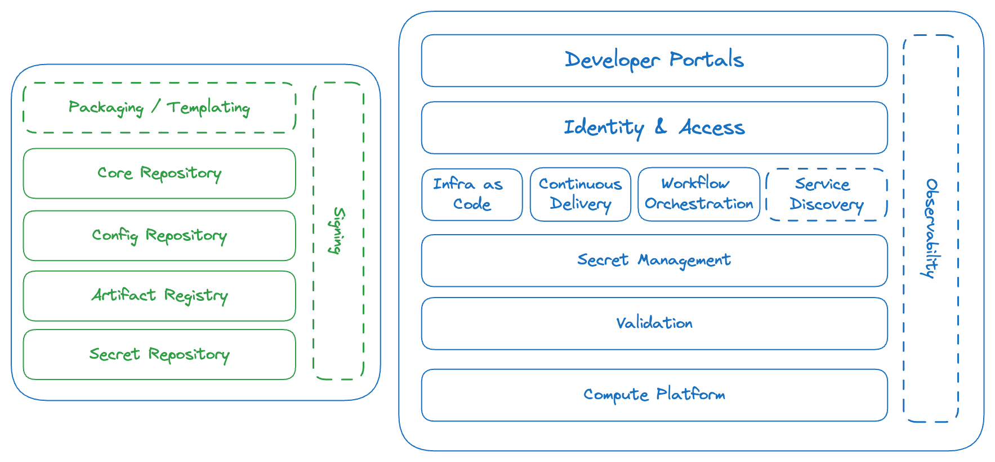
Internal Developer Platform - Capabilities
Principles
Support
Architecture

Slide 30
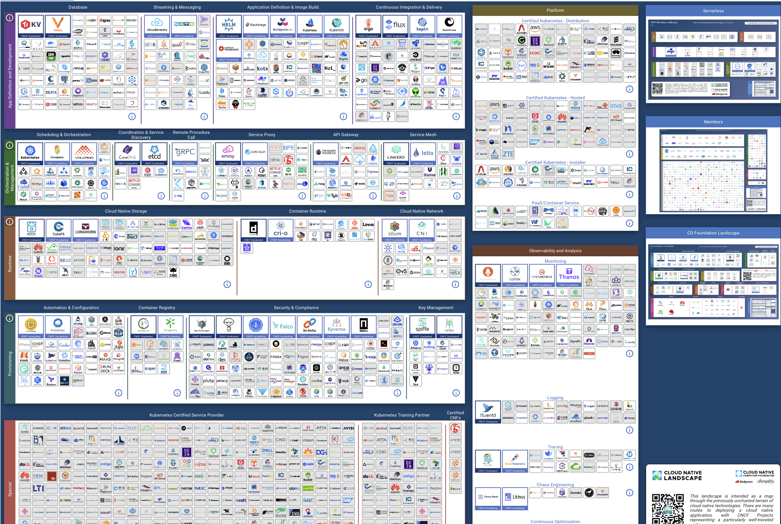
Cloud Native Landscape
Principles
Support
Architecture

Slide 31
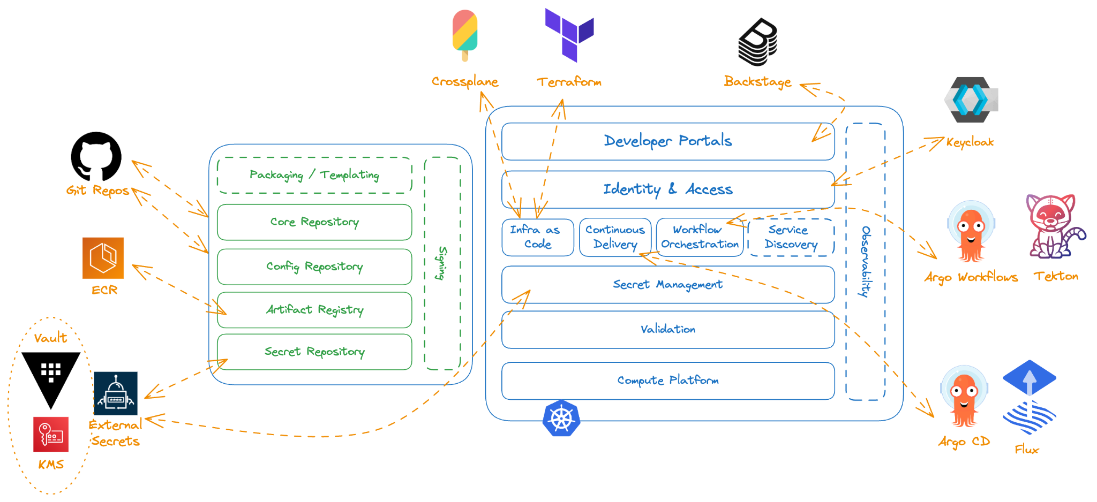
Reduce Technology Choices
Principles
Support
Architecture

Slide 32

Standardization vs. Autonomy: The Platform Engineering Balance
Principles
Support
Architecture
Autonomy?
Standardization

Slide 33
Accelerate Building Your IDP
Mission
Support
Architecture

Slide 34
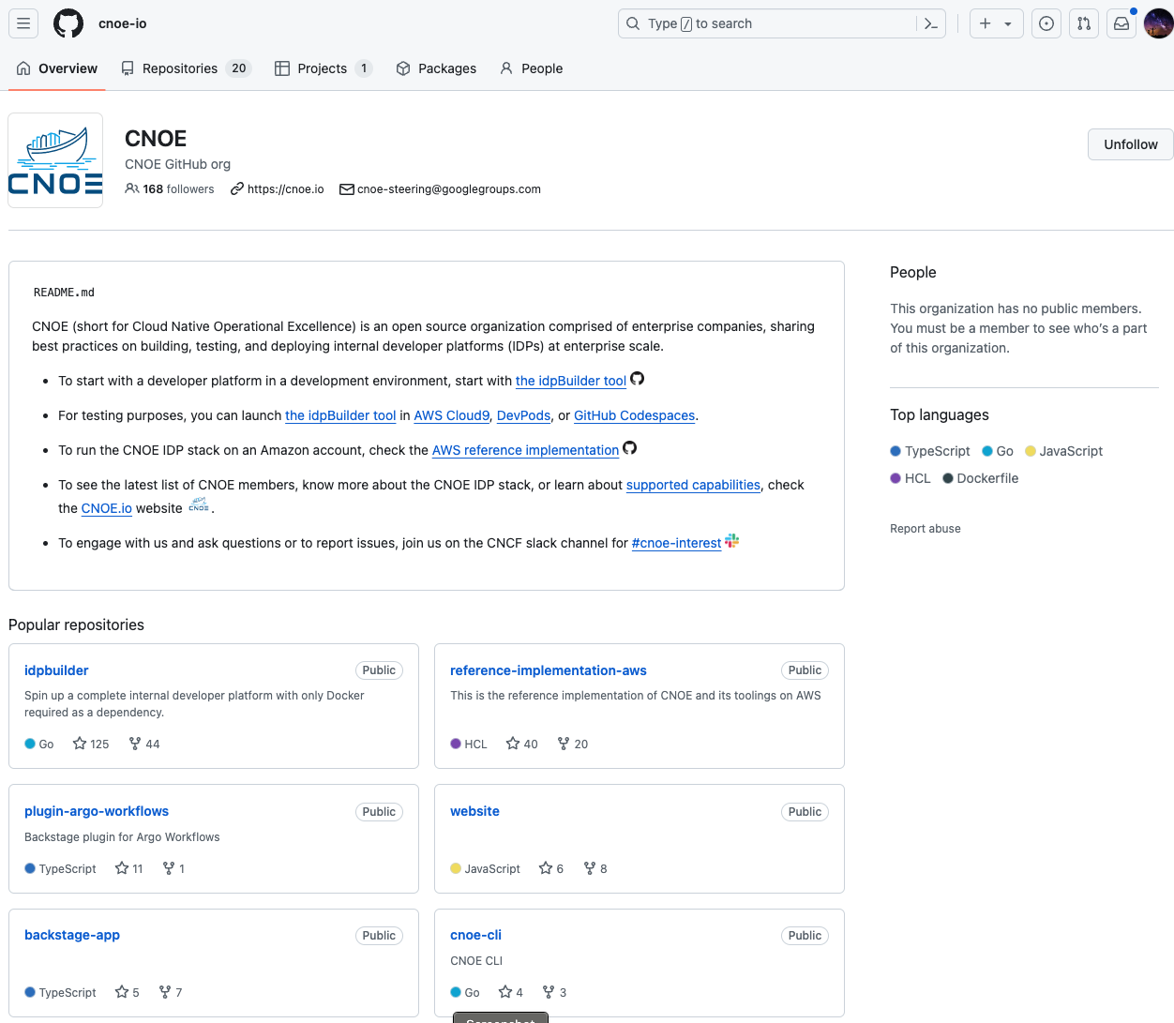
Accelerate Building Your IDP
Principles
Support
Architecture

Slide 35
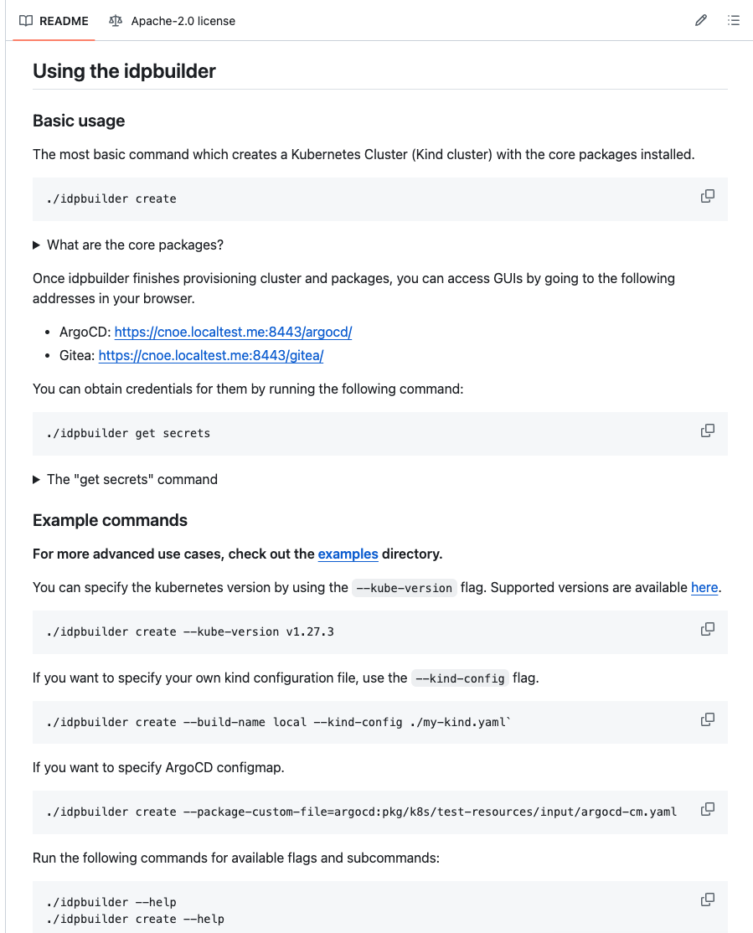
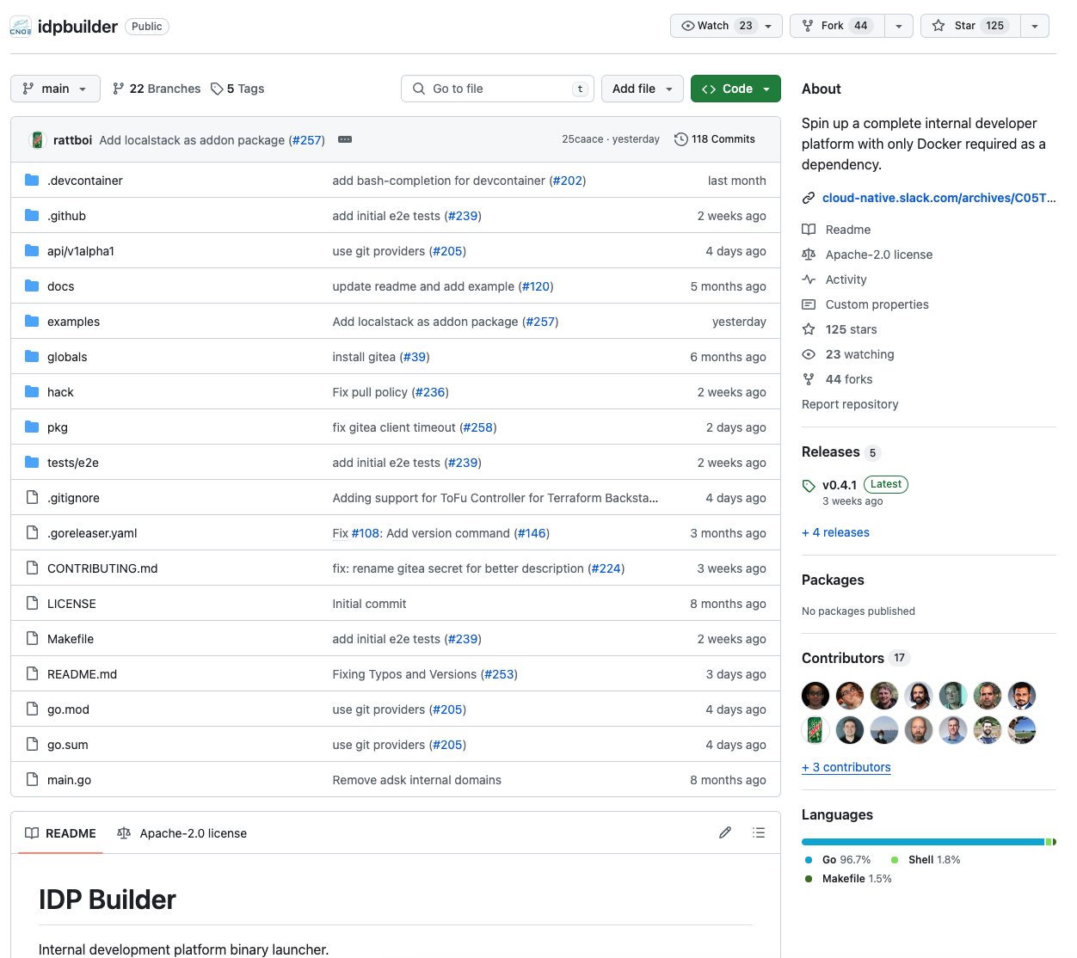
Accelerate Building Your IDP
Principles
Support
Architecture
https://github.com/cnoe-io/idpbuilder

Slide 36
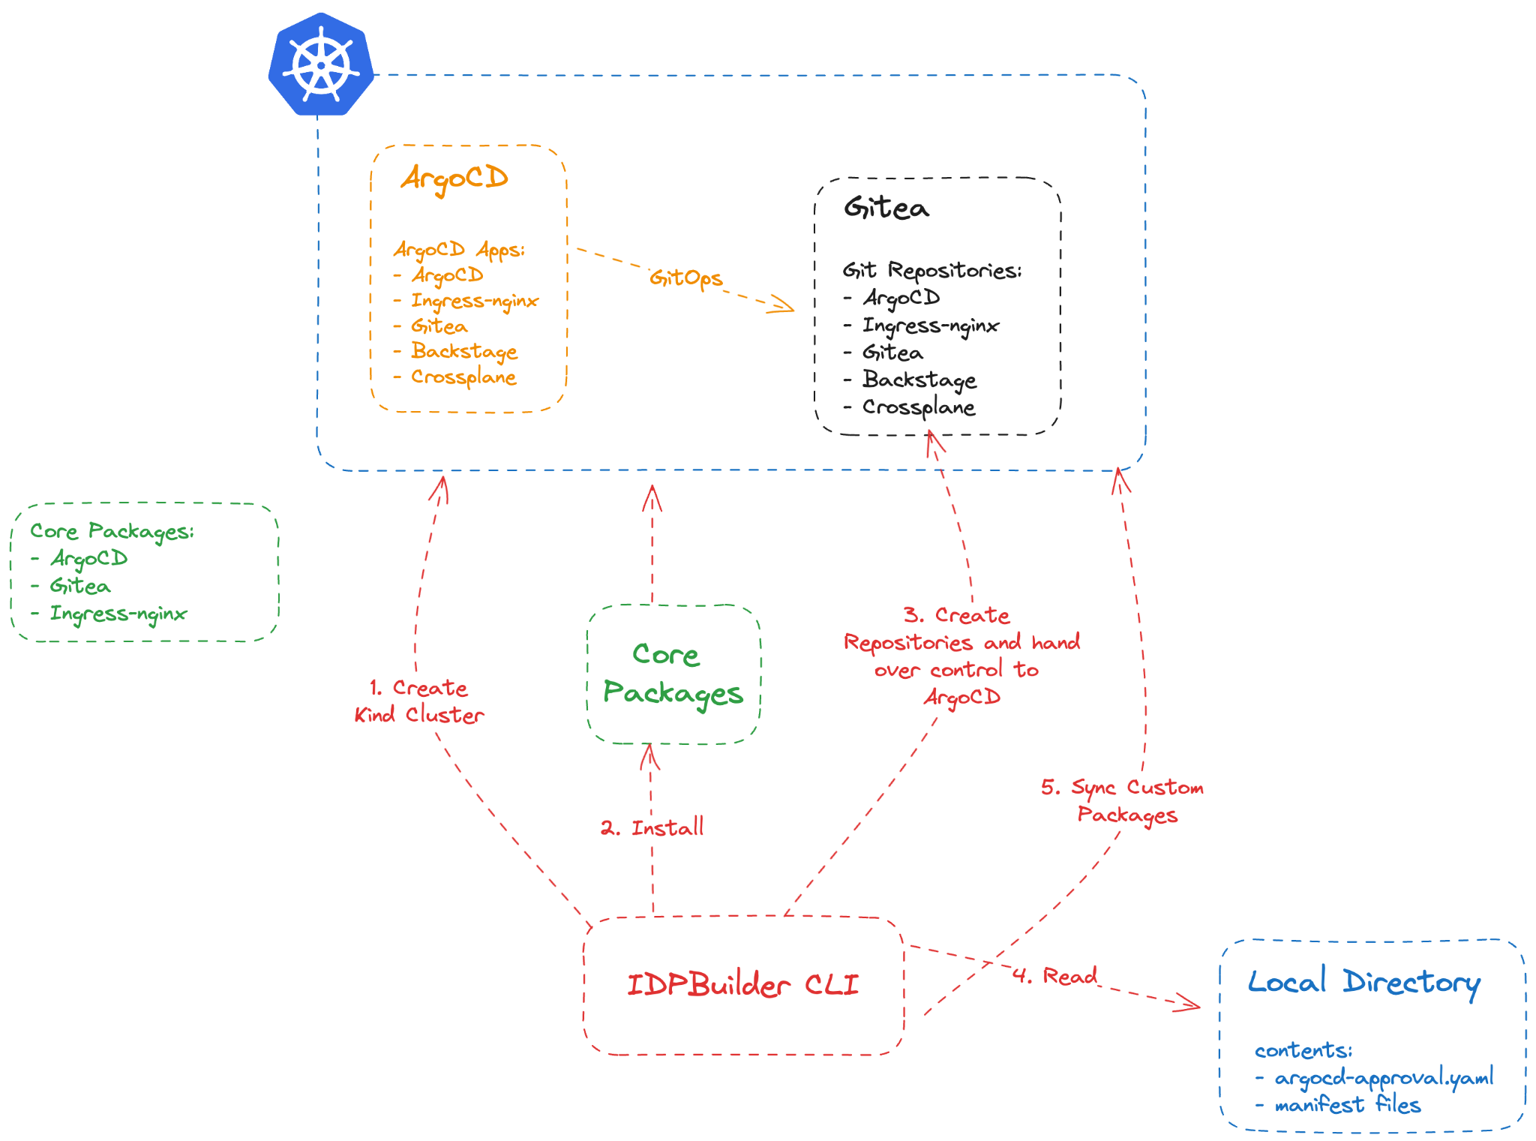
Accelerate Building Your IDP
Principles
Support
Architecture

Slide 37
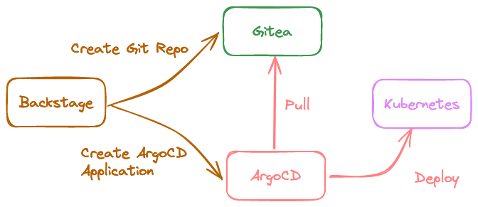
Accelerate Building Your IDP
Principles
Support
Architecture

Slide 38

Demo
Principles
Support
Architecture
:magic:

Slide 39

Accelerate Building Your IDP
Principles
Support
Architecture

Slide 40
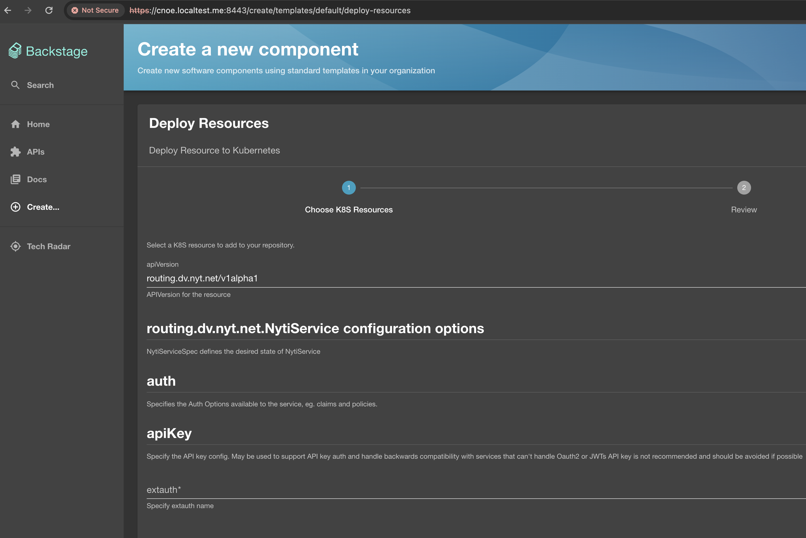
Accelerate Building Your IDP
Principles
Support
Architecture

Slide 41
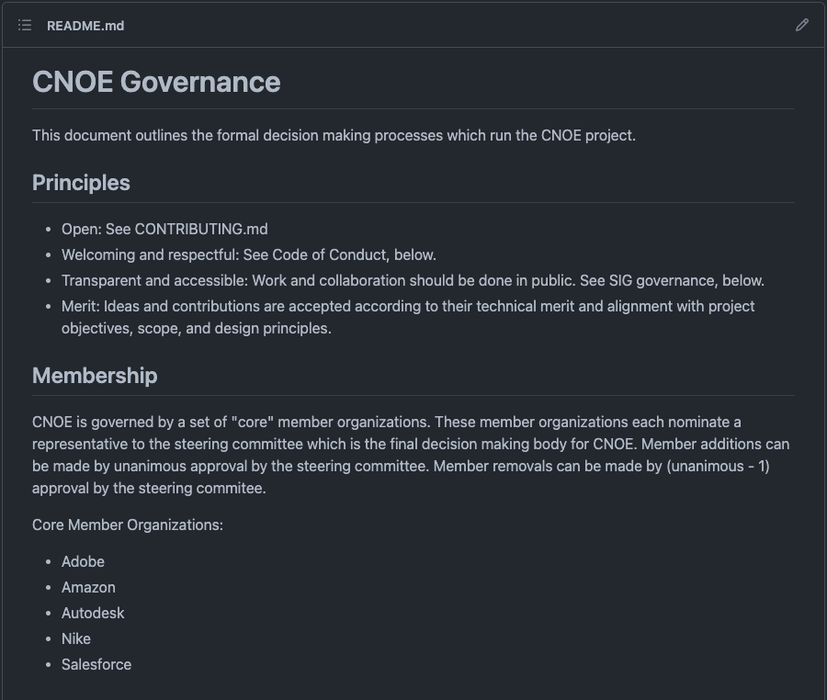
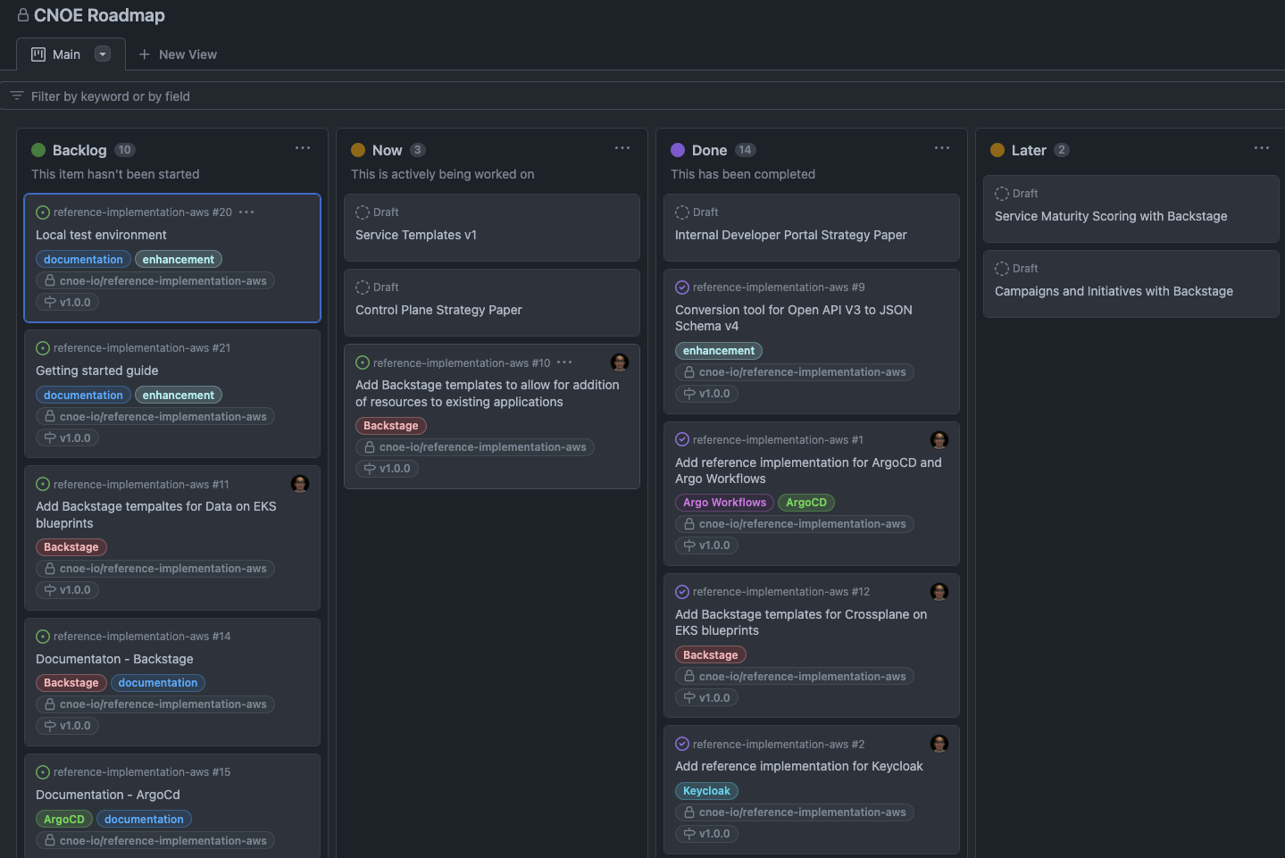
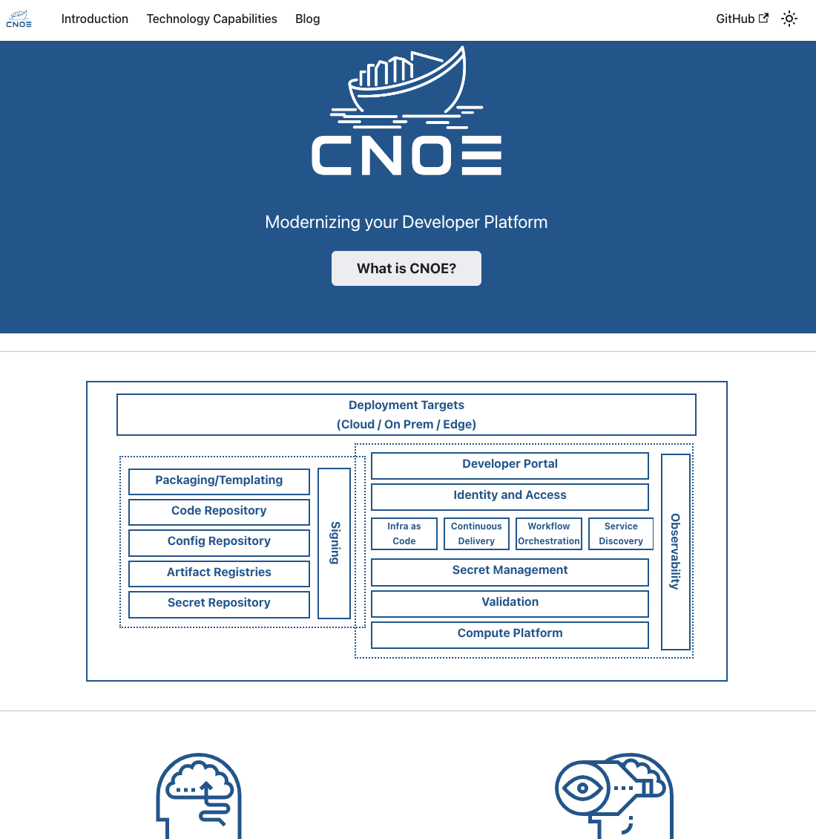
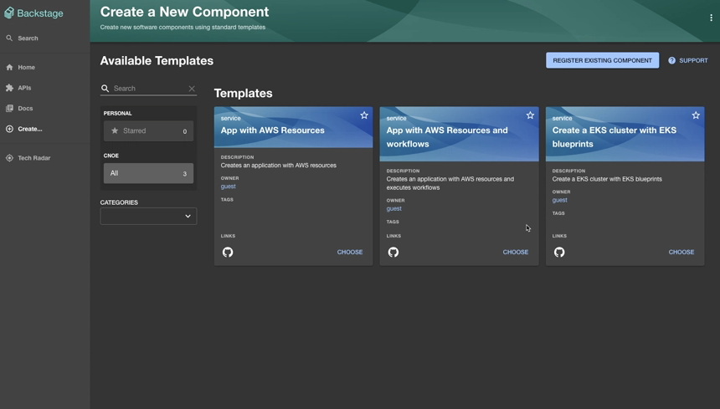
How is CNOE progressing?
Principles
Support
Architecture
The Governance Model
Project Roadmap
https://cnoe.io
#cnoe-interest on CNCF slack

Slide 42
Conclusion
Principles
Support
Architecture
Our platform journeys are similar
We’re all navigating this CNCF landscape
Understand your Principles, Support, and Architecture
Start with a Reference Architecture and contrast to your needs
Engage with the community
Improve the architecture
share experiences to improve for all

Slide 43


Thank You!
Thanks to CNOE community in their support for this talk
Jesse Sanford - Nima Kaviani - Carlos Santana - Greg Haynes - Manabu McCloskey
@tiara-sykes
@tiara-sykes-nyt
@lukephilips
@lukepatrick

